Slide 1
Flow Charts, Loop Structures

Slide 2
Flowcharts
Flowcharts are diagrams that illustrate the paths followed in a sequence of computations
Flowcharts are a great tool for planning complex algorithms
Flowcharts are also very useful for documenting and explaining an algorithm, even relatively simple ones
For many of the simple programs we will write, drawing a flowchart may seem to be unnecessary, but learning to create and read flow charts is a valuable skill

Slide 3
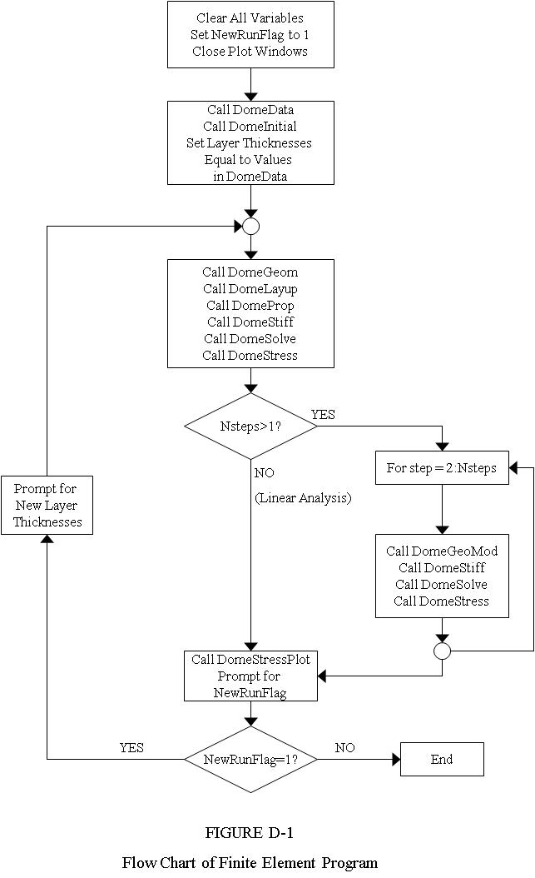
Example Flowchart
In this example, many subroutines are used
Often, a complex program is organized into a series of subroutines
Notice the decisions points (diamonds) and loops – several subroutines are repeated many times

Slide 4
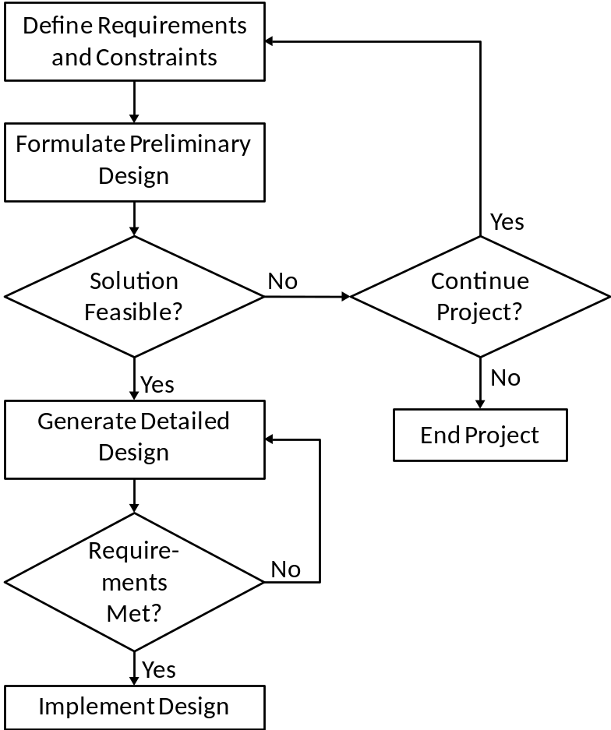
Flowcharts
Flowcharts are often used to illustrate process sequences in manufacturing operations and decision-making sequences in management
Consider the flowchart of a company’s product design process:

Slide 5
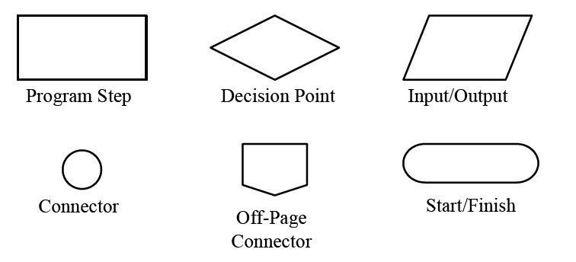
Typical Flowchart Symbols
These symbols are not always used, but the diamond-shaped Decision Point can be considered a universal standard

Slide 6
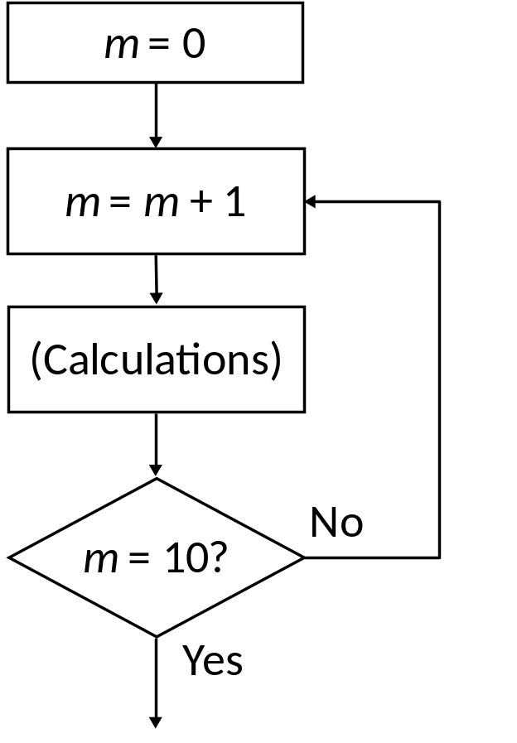
The for Loop in MATLAB
Also called a do loop in other languages
Used when you want the calculations to be performed a defined number of times
In this example, the calculations are performed 10 times

Slide 7
The for Loop in MATLAB
In MATLAB, a for loop begins with the statement indicating how many times the statements in the loop will be executed
A counter is defined within this statement
Examples:
  for k = 1:100
  (counter = k, the loop will be executed 100 times)
    for i = 1:2:7
    (counter = i, the counter will be incremented by a value of 2 each time until its value reaches 7. Therefore, the loop will be executed 4 times (i = 1,3,5, and 7)

Slide 8

The for Loop in MATLAB
The loop ends with an end statement
In M-files, the MATLAB editor will automatically indent text between the for and end statements:
Can you determine what the variable x will be after running this M-file?

Slide 9
for Loop Example
The first time through the loop, j = 1
Because of the single value in parentheses, x will be a one-dimensional array
x(1) will be set equal to 5*1 = 5
The second time through the loop, j = 2
x(2) will be set equal to 5*2 = 10
This will be repeated until j = 10 and x(10) = 50

Slide 10
for Loop Example
x will be a one-dimensional array (a row matrix) with 10 elements:

Slide 11
Condensed Form of for Loop Flowchart
Note the use of the connector symbol where paths join
Good practice to add connectors to flowcharts of MATLAB programs: a connector corresponds to an end statement
for m = 1:10
(Calculations)

Slide 12
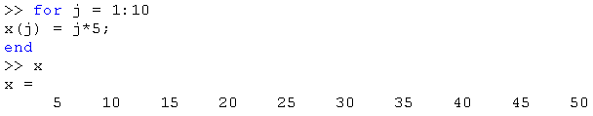
for Loop in Interactive Mode
Loop commands can be entered directly from the command prompt
The calculations are not performed until the end statement is entered

Slide 13
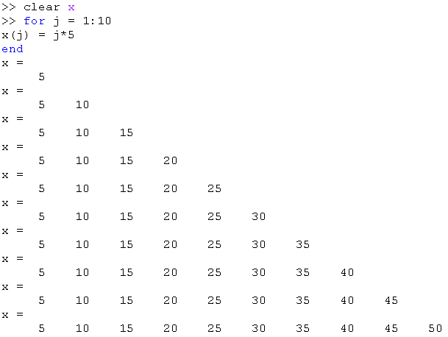
for Loop in Interactive Mode
Remember that if you leave off the semi-colon, the results of the calculations will be written to the screen in every loop:

Slide 14

for Loop Examples
What result will be output to the screen in each of the following examples?
    y = 0;
    for k = 1:5
    y = y + k;
    end
    y

Slide 15

for Loop Examples
    y = 0;
    for k = 2:2:8
    y = y + k;
    end
    y

Slide 16

for Loop Examples
    for k = 1:5
    y(k)=k^2;
    end
    y

Slide 17

for Loop Examples
  for j = 1:3
  for k = 1:3
  T(j,k) = j*k;
  end
  end
  T

Slide 18

for Loop Example
Consider this equation:
Plot this equation for values of x from -10 to 10
We will use a for loop to calculate and store x and y values in one-dimensional arrays

Slide 19
for Loop Example
    for i = 1:21
    x(i) = -10 +(i-1);
    y(i) = 2^(0.4*x(i)) + 5;
    end
After running these lines of code, two one-dimensional arrays, x and y, have been created, each with 21 elements

Slide 20
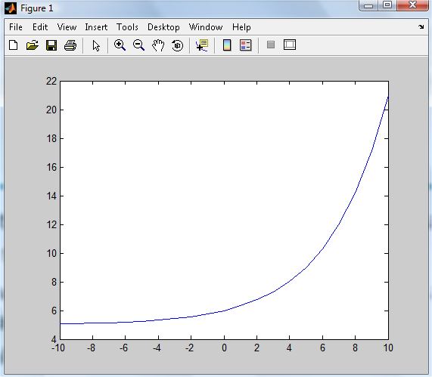
Plot Command
The stored arrays can be plotted with the command:
  plot(x,y)
Any two one-dimensional arrays can be plotted, as long as they are exactly the same size
The plot will be created in a new window
We will learn how to format MATLAB plots later

Slide 21
for and while Loops in MATLAB
A for loop will be executed a fixed number of times
A while loop will continue to be repeated until some condition is satisfied
Examples: Consider an amount of money deposited in an interest-bearing account
If we want to calculate the value in the account after 10 years, then we would use a for loop
If we want to determine how long it will take until the account reaches $100,000, then we would use a while loop

Slide 22
Flow Chart of while Loop
The first line of this loop is:
while (condition)
Last line is:
end
(calculations)
Condition
true?
Yes
No

Slide 23
Condensed Form of while Loop Flowchart
while [condition]
(Calculations)

Slide 24
Example
Consider this loop:
k = 0;
while k < 10
k = k + 2
end
How many times will the loop be executed?
Initially, k = 0, so the loop is entered
Pass #1: k = 2, so execution continues
Pass #2: k = 4, so execution continues
Pass #3: k = 6, so execution continues
Pass #4: k = 8, so execution continues
Pass #5, k = 10, so k is not less than 10 and execution ends

Slide 25
while Example
Suppose you borrow $10,000 at an interest rate of 6%, compounded monthly.
Therefore, each month, the amount owed increases by 0.5% (6% divided by 12) and decreases by the amount of the monthly payment that you make
How many months will it take to completely pay back the loan, if the monthly payment is
    $500
    $200
    $100

Slide 26
Flow Chart of Example
Define Payment P
Balance B = 10,000
Months m = 0
while B > 0
B = B*(1.005)
B = B – P
m = m + 1
Output m, B

Slide 27
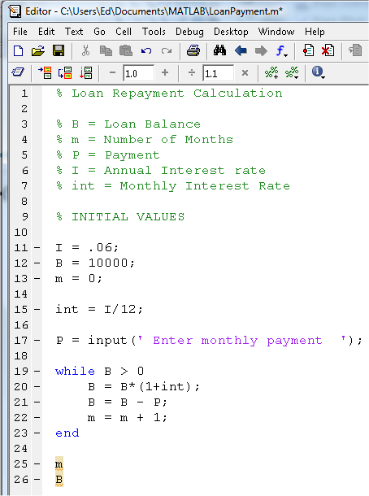
m-File
Note the use of the input command: P is assigned the value entered at the prompt given in single quotes

Slide 28
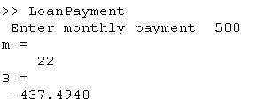
Results
Payment = $500:
The loan would be repaid in 22 months
After the 22nd payment, the balance of $437 would be returned to the borrower

Slide 29
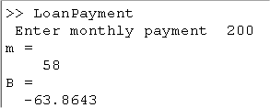
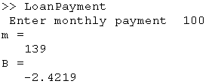
Results
Payment = $200
Payment = $100

Slide 30


Results
Try Payment = $45:
The calculations will continue until you press ctrl+C to stop execution

Slide 31
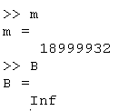
Results
Check m and B after stopping the calculations:
After making payments for more than 1,000,000 years, you owe more money than MATLAB can calculate. This won’t look good on your credit report!

Slide 32
Infinite Loops
When using a while loop, there is a danger of encountering an infinite loop
Since termination of the loop is dependent upon achieving some condition (in this case, a balance of less than or equal to zero), it is possible that the condition will never be reached, and therefore the looping will continue endlessly
In our example, the interest after the first month was $50 (1/2% of $10,000). If the payment was less than $50, then the balance increased every month

Slide 33

Practice
What are the values of A and m after execution of these MATLAB commands:
    m = 0;
    A = 20;
    while A <= 50
    A = A + 5;
    m = m + 1;
    end
    A
    m

Slide 34

Practice
What are the values of A and m after execution of these MATLAB commands:
    m = 0;
    A = 100;
    while A > 15
    A = A/2;
    m = m + 1;
    end
    A
    m

Slide 35
Practice
What are the values of A and m after execution of these MATLAB commands:
    m = 0;
    A = 10;
    while A > 0
    A = sqrt(A);
    m = m + 1;
    end
    A
    m
Infinite Loop: the square root will never reach zero

